Slide 1
Agile Treasury, Real Results:
Cash Visibility at Scale
Bruce Edlund
Group Director, Assistant Treasurer at Cloud Software Group
Paul Bramwell
Enterprise Treasury Lead, Trovata

Slide 2


Paul Bramwell
Paul is Trovata's Enterprise Treasury Lead and brings over 3 decades of experience in the corporate treasury world. Paul has worked for two of the largest treasury system vendors in various senior roles and was a Partner in Ernst & Young's treasury advisory service. Paul has worked with some of the largest and most complex global treasury groups in all aspects of the treasury function. Originally from the UK, Paul has lived in the US since 2003 and is a self-confessed tech addict who likes to read user manuals for fun.

Slide 3
Bruce Edlund
Bruce Edlund, Group Director and Assistant Treasurer at Cloud Software Group, brings over 20 years of corporate treasury experience. He began in investment banking before building deep expertise in cash and liquidity management, forecasting, FX and interest rate hedging, debt markets, and stock buybacks. His career spans public and private companies across telecom, retail, and IT, with roles at Walmart and Citrix. Fluent in English, Spanish, and French, he has worked across the U.S., Latin America, and Europe. Outside of work, he enjoys food, wine, cycling, hiking, and photography.

Slide 4
Agenda
What Agility Really Looks Like & Why it Matters
The Core Drivers of Agility
Why Your Tech is Make or Break
Cloud Software Group’s Story
How AI is Fueling the Next Level of Agility

Slide 5
What Does Agility Mean for Treasury?
What it Means
Real-time data you can trust
Quick answers to even the toughest questions
Empowering other teams, minus the friction
Less reliance on IT, SQL, or consultants
Why it Matters
Take advantage of more opportunities
Act confidently & swiftly during a crisis
Succeed in both bull and bear markets
Keeping up with the latest technology serves the business as well as your career prospects
Notes:
Bruce: agility = fewer annoying questions
Paul: agility = moving away from dependence on IT, SQL, or consultants

Slide 6




Accurate, Accessible Data
Data that flows automatically and is aggregated in real time using an API-first approach to connectivity.
The Key
Drivers of
Agility
An Intuitive, Integrated System
An easy to use platform that serves as a source of truth for bank & ERP data that can feed other systems and departments.
Automation & AI
Tools that reduce time spent on number crunching and reporting so you can spend more time on strategy.

Slide 7
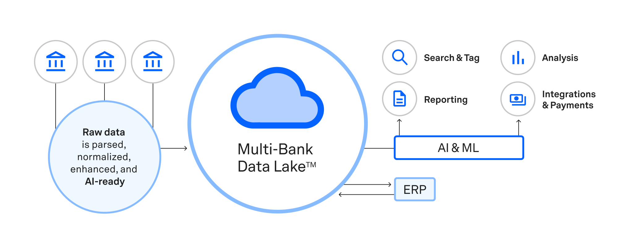
An API-First Platform Unlocks Agility

Slide 8
Cloud Software Group’s Transformation
Before
300+ accounts and over 100 entities
No real-time cash visibility or centralized control
After
Automatic bank data aggregation for over 100 global entities via an API-first platform
Real-time dashboards using advanced search & tagging capabilities
Powers internal apps with custom developer APIs
Automated transaction reconciliation across banks
Business Outcomes
A shared data platform across the business
Improved visibility into global cash flow
Reduced bank portal access fees via centralized data
Treasury gained control without IT support
Reporting scaled across multiple stakeholders
The treasury department now has a stronger voice in shaping company

Slide 9
AI & The Next Level of Agility
Type of AI | What it Does | Use Cases | Maturity in Treasury
Machine Learning | Performs specific, rule-based tasks with data-driven learning | Transaction tagging, fraud detection, forecast baseline modeling | Widely used
Generative AI | Creates new content based on prompts (text, reports, insights, code, etc.) | Automated reporting, cash insights, assistant-like interfaces | Emerging
Agentic AI | A co-pilot executes multi-step tasks independently, adapts based on feedback | Detecting a cash shortfall → modeling → alerting AP with a plan | Early-stage / Experimental

Slide 10
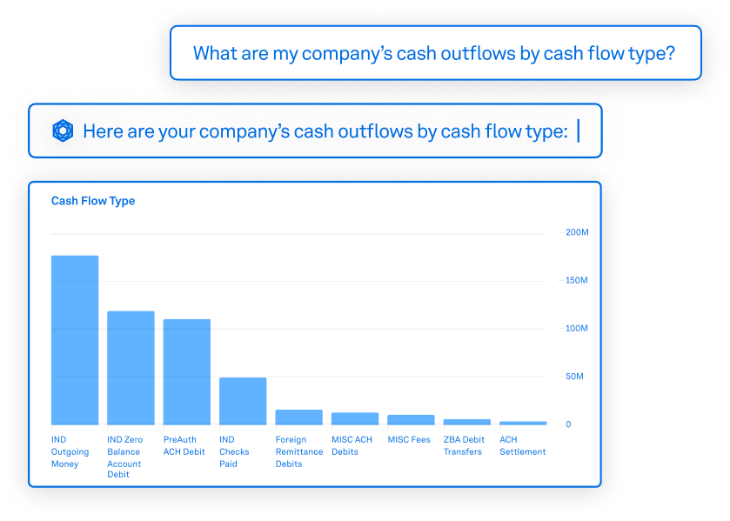
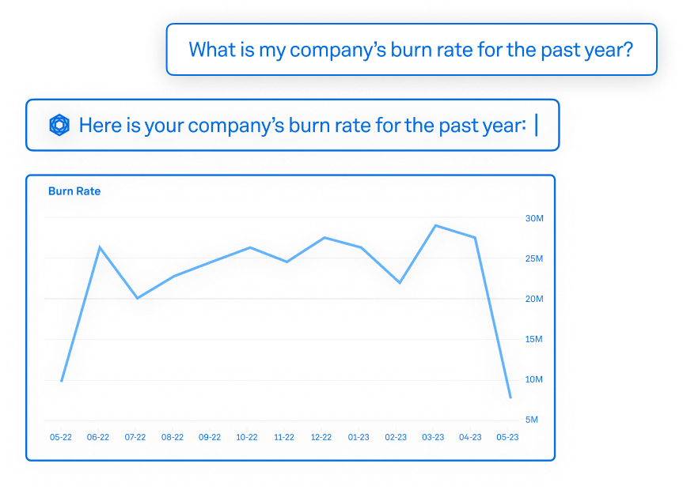
AI: Your Next Employee?

Slide 11
Q&A
Paul Bramwell
Bruce Edlund
Learn more at Trovata.io
Connect with Paul: paul.bramwell@trovata.io

